Slide 1

Chapter 7: Static Modeling

Slide 2
Introduction
The static model addresses the static structural view of a problem, which does not vary with time. In particular, a static model defines the classes in the system, the attributes of the classes, the relationships between classes, and the operations of each class. It is depicted in class diagrams.
The concepts of objects, classes, and class attributes are described in Chapter 4.
This chapter:
Describes the relationships between classes.
This chapter addresses special considerations in static modeling of the problem domain, including static modeling of the total system context and software system context, as well as static modeling of entity classes.

Slide 3
Contents
1. Relationships
2. Constraint
3. Static modeling and the UML
4. Static modeling of the system context
5. Categorization of classes using UML stereotypes
6. Modeling external classes
7. Static modeling of entity classes

Slide 4
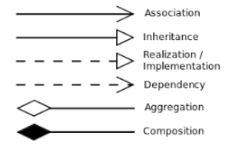
1. Relationships
There are six main types of relationships between classes: inheritance, realization/implementation, composition, aggregation, association, and dependency.

Slide 5
1.1. Associations between classes
An association defines a relationship between two or more classes, denoting a static, structural relationship between classes
A link is a connection between instances of the classes (objects) and represents an instance of an association between classes
The multiplicity of an association specifies how many instances of one class can relate to a single instance of another class.
Example: Employee Works in Department, where Employee and
Department are classes and Works in is an association

Slide 6
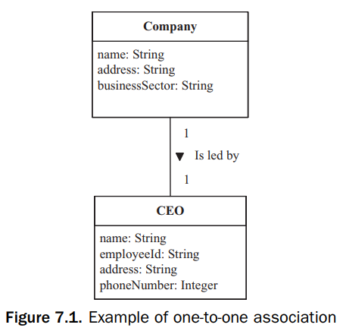
Multiplicity of associations
Multiplicity of an association specifies how many instances of one class can relate to a single instance of another class
One-to-one association. In a one-to-one association between two classes, the association is one-to-one in both directions. Thus, an object of either class has a link to only one object of the other class.
Direction:
Association names usually read from left to right and top to bottom.
However, on a large class diagram: uses arrowhead.

Slide 7
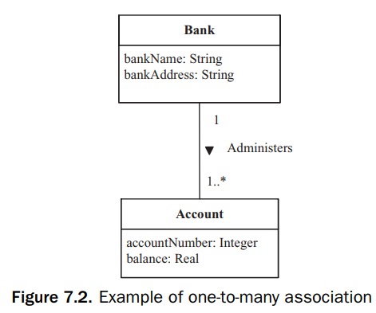
Multiplicity of associations
One-to-many association. In a one-to-many association:
there is a one-to-many association in one direction between the two classes
and a one-to-one association between them in the opposite direction.

Slide 8
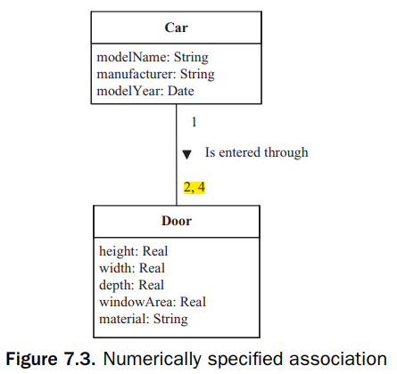
Multiplicity of associations
Numerically specified association: an association that refers to a specific number
For example: the association Car Is entered through Door

Slide 9
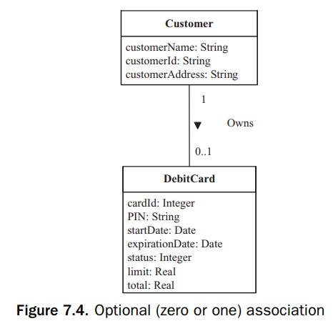
Multiplicity of associations
Optional association. In an optional association, there might not always be a link from an object in one class to an object in the other class
Optional = 0 or 1
For example: the association Customer owns Debit Card

Slide 10
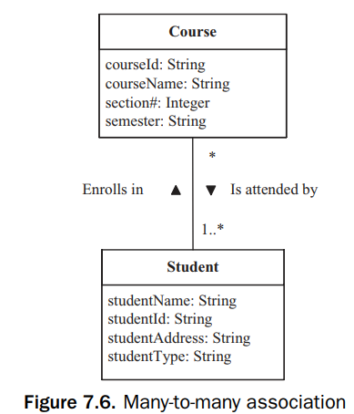
Multiplicity of associations
Many-to-many association. A many-to-many association is an association between two classes with a one-to-many association in each direction.
For example: association Course Is attended by Student,
Student Enrolls in Course

Slide 11
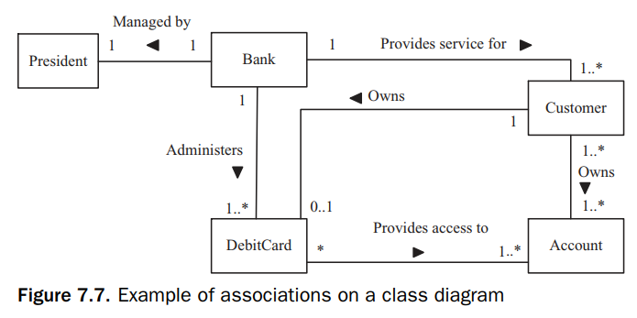
Example

Slide 12
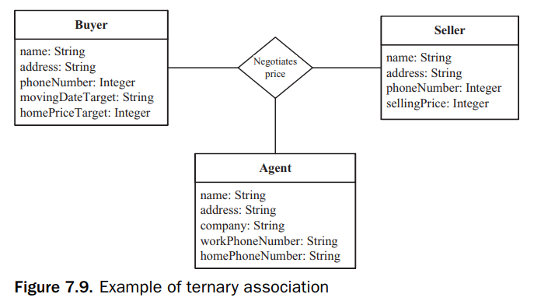
Ternary associations
A ternary association is a three-way association among classes.
The association is that the Buyer negotiates a price with the Seller through an Agent
Notation: The ternary association is shown as a diamond joining the three classes

Slide 13
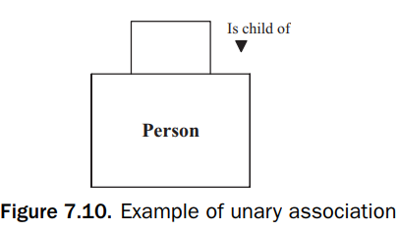
Unary Associations
A unary association, also referred to as a self-association, is an association between an object of one class and another object in the same class.
Example: Person Is child of Person, Person Is married to Person, and Employee Is boss of Employee.

Slide 14
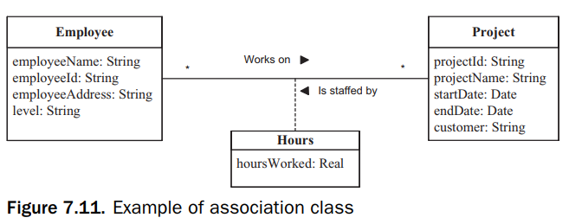
Association Classes
An association class is a class that models an association between two or more classes. The attributes of the association class are the attributes of the association.
In a complex association between two or more classes, it is possible for an association to have attributes.
This happens most often in many-to-many associations, where an attribute does not belong to any of the classes but belongs to the association.

Slide 15
1.2. Composition and aggregation hierarchies
Both composition and aggregation hierarchies address a class that is made up of other classes.
Composition and aggregations are special forms of a relationship in which classes are connected by the whole/part relationship A composition is a stronger relationship than an aggregation, and an aggregation is a stronger relationship than an association
A composition is also a relationship among instances. Thus, the part objects are created, live, and die together with the whole. The part object can belong to only one whole.

Slide 16
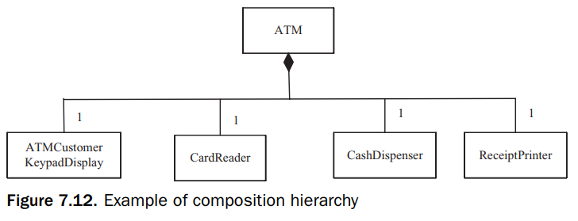

1.2. Composition and aggregation hierarchies
A composition is also a relationship among instances. Thus, the part objects are created, live, and die together with the whole. The part object can belong to only one whole.
A composite class often involves a physical relationship between the whole and the parts

Slide 17
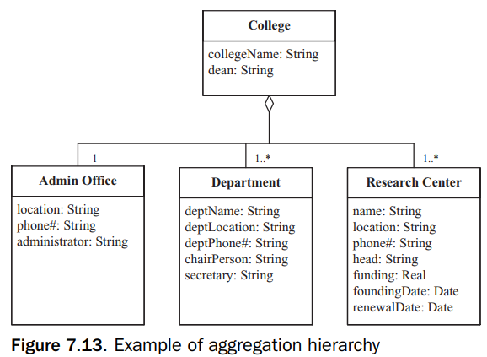
1.2. Composition and aggregation hierarchies
The aggregation hierarchy is a weaker form of whole/part relationship. In an aggregation, part instances can be added to and removed from the aggregate whole.
Aggregations are likely to be used to model conceptual classes rather than physical classes. In addition, a part could belong to more than one aggregation

Slide 18
Relationship examples
University – Department
Department - Professors
House - Room
Room - Bill

Slide 19
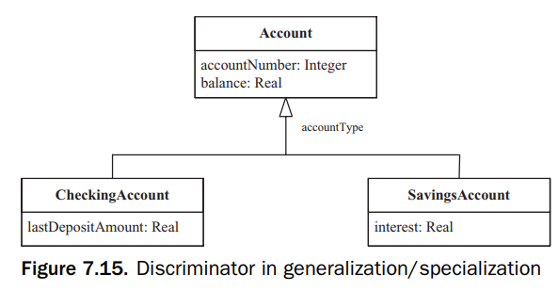
1.3. Generalization/specialization hierarchy
In a generalization/specialization hierarchy, common attributes are abstracted into a generalized class, which is referred to as a superclass.
The different attributes are properties of the specialized class, which is referred to as a subclass. There is an Is a relationship between the subclass and the superclass.
The subclass inherits the attributes and the operations from the superclass

Slide 20
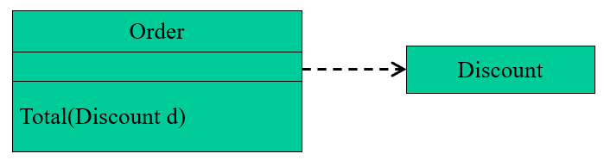
1.4. Dependency relationships
A dependency relationship is a relationship in which one element, the client, uses or depends on another element, the supplier.
We can use dependency relationships in class diagrams, component diagrams, deployment diagrams, and use-case diagrams to indicate that a change to the supplier might require a change to the client.
Ex: an Order class depends on a Discount class because the Order class uses the Discount class as a parameter for a Total operation

Slide 21
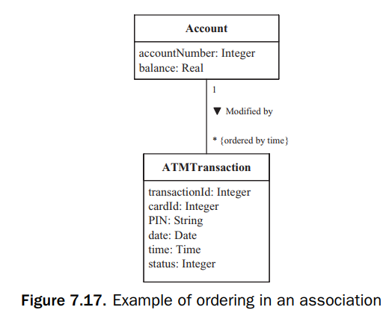
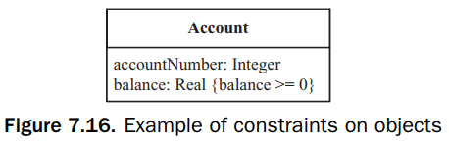
2. Constraint
A constraint specifies a condition or restriction that must be true. A constraint is expressed in any textual language.
Constraint expressions are used to restrict the possible values of an attribute and an association link
Constraint on the attribute is shown next to the attribute to which it applies

Slide 22
3. Static modeling and the UML
In the analysis phase, the static model is used to model and help understand the problem domain.
The goal is to focus on those parts of the problem domain that benefit most from static modeling, particularly the physical classes and the data-intensive classes, which are called entity classes.
Physical classes are classes that have physical characteristics such as physical devices (embedded applications), users, external systems, and timers.
Entity classes are conceptual data-intensive classes that are often persistent – that is, long-living. Entity classes are particularly prevalent in information systems (for example: accounts and transactions in bank systems).

Slide 23
4. Static modeling of the system context
Context modeling explicitly identifies what is inside the system and what is outside.
Context modeling can be done at the total system (hardware and software) level or at the software system (software only) level.
A diagram that explicitly shows the border between the system (hardware and software), which is treated as a black box, and the external environment is called a system context diagram
A diagram that explicitly shows the border between the software system, also treated as a black box, and the external environment (which now includes the hardware) is called a software system context diagram
In developing the system context diagram, it is helpful to consider the context of the total hardware/software system before considering the context of the software system.

Slide 24
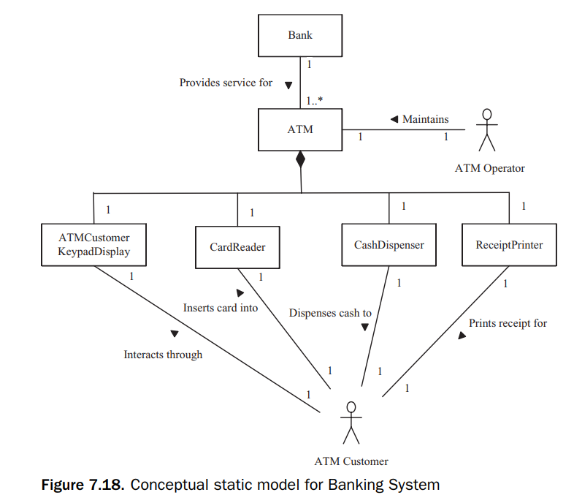
Example
All the others entities shown in Figure 7.18, in particular the I/O devices, which include the card reader, cash dispenser, receipt printer, and the ATM Customer keypad/display, are part of the total hardware/software system

Slide 25
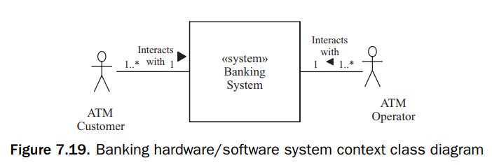
Example
From the total system perspective (both hardware and software), the ATM Customer and ATM Operator actors are external to the system

Slide 26
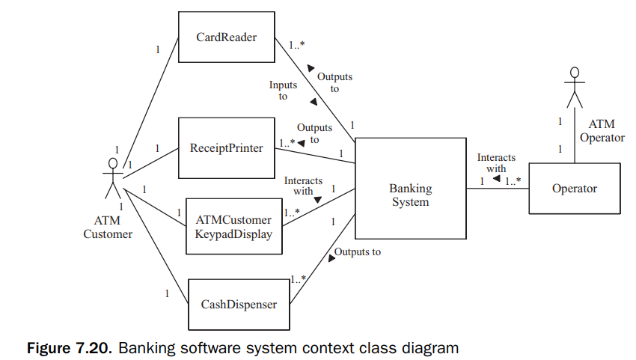
Example
From a software perspective, the I/O devices are external to the software system.
On the software system context class diagram, the I/O devices are modeled as external classes.

Slide 27
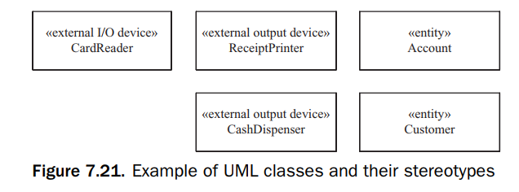
5. Categorization of classes using UML stereotypes
In class structuring, the COMET method advocates categorizing classes in order to group together classes with similar characteristics.
In UML, stereotypes are used to distinguish among the various kinds of classes. A stereotype is a subclass of an existing modeling element
In software applications, a class is categorized by the role it plays in the application («entity», «boundary», «control»)

Slide 28
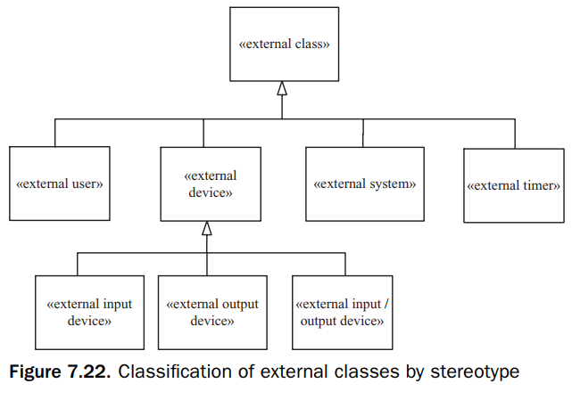
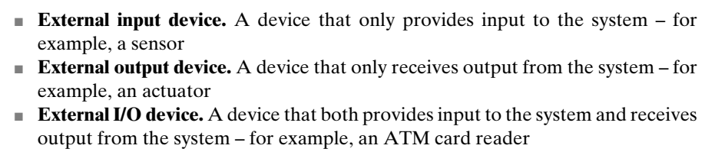
6. Modeling external classes
the system context is depicted showing the hardware/software system as an aggregate class with the stereotype «system», and a software system with the stereotype «software system».
External classes are categorized by stereotype as in Fig 7.22

Slide 29
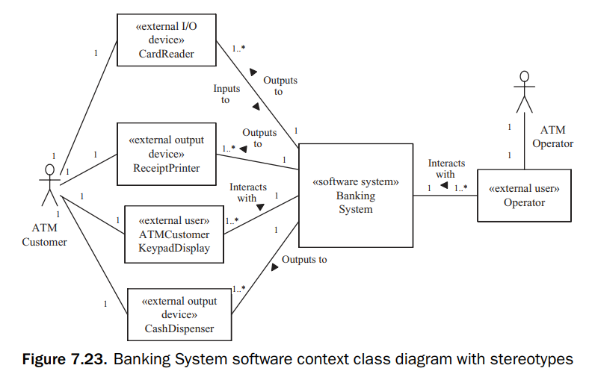
Example: Banking System software context class diagram with stereotypes

Slide 30
Actors and External Classes
Analyzing actors that interact with the system, actors are a more abstract concept than external classes. The relationship between actors and external classes is as follows:
An I/O device actor is equivalent to an external I/O device class. This means the I/O device actor interfaces to the system via an external I/O device class.
An external system actor is equivalent to an external system class.
A timer actor interfaces to the system via an external timer class, which provides timer events to the system.
A human user actor has the most flexibility. In the simplest case, the user actor interfaces to the system via standard user I/O devices, such as a keyboard, visual display, and mouse. The external class is given the name of its user actor because what is of interest is the logical information coming from the user. However, in more complex use cases, it is possible for a human actor to interface with the system through a variety of external classes (Fig 7.23).

Slide 31
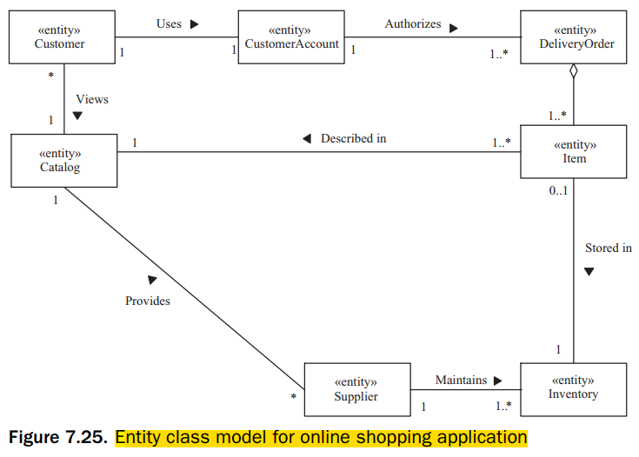
7. Static modeling of entity classes
Entity classes are conceptual data-intensive classes – that is, their main purpose is to store data and provide access to this data. In many cases, entity classes are persistent, meaning that the data is long-living and would need to be stored in a file or database.
Entity classes are often mapped to a database in the design phase, as described in Chapter 15.

Slide 32
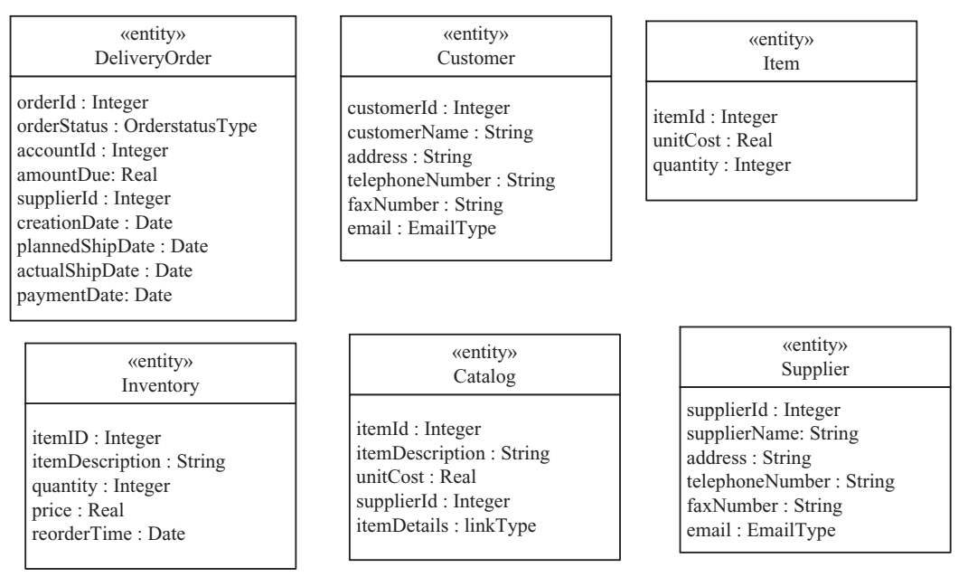
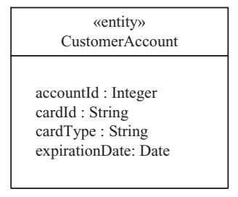
8. Modeling Class Attributes
An important consideration in modeling entity classes is to define the attributes of each entity class. An entity class is data-intensive, meaning that it has several attributes

